Slide 1
Chapter 23
Using and Building Generative AI Applications
Business Analytics:
Managing, Building, and Using Analytical Systems
Hugh J. Watson

Slide 2
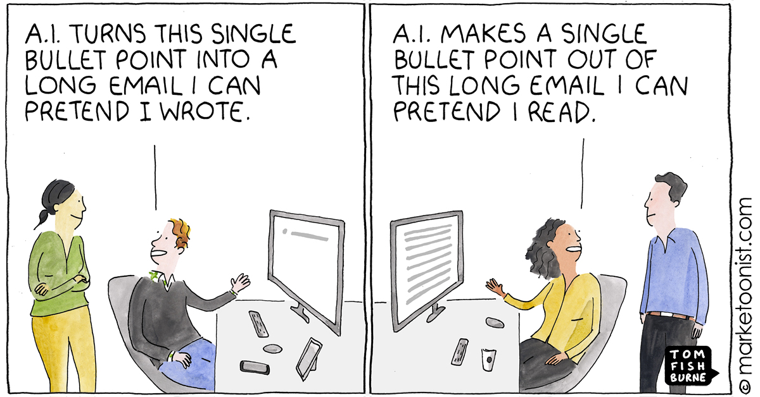
What Is Generative AI and What Does It Do?
It is a type of AI system
Responds to prompts (e.g., inputs) entered by users
Creates new outputs, such as text, images, music, and videos
It is based on a deep learning model trained with large amounts of data
In the case of ChatGPT, and similar systems, it predicts the next word given the conversation that has occurred so far

Slide 3
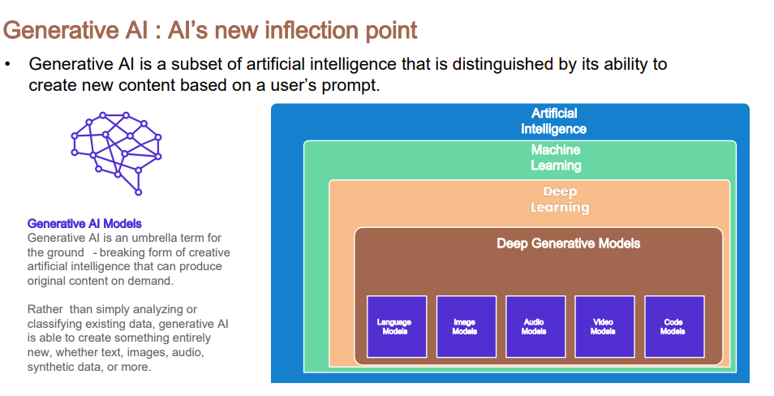
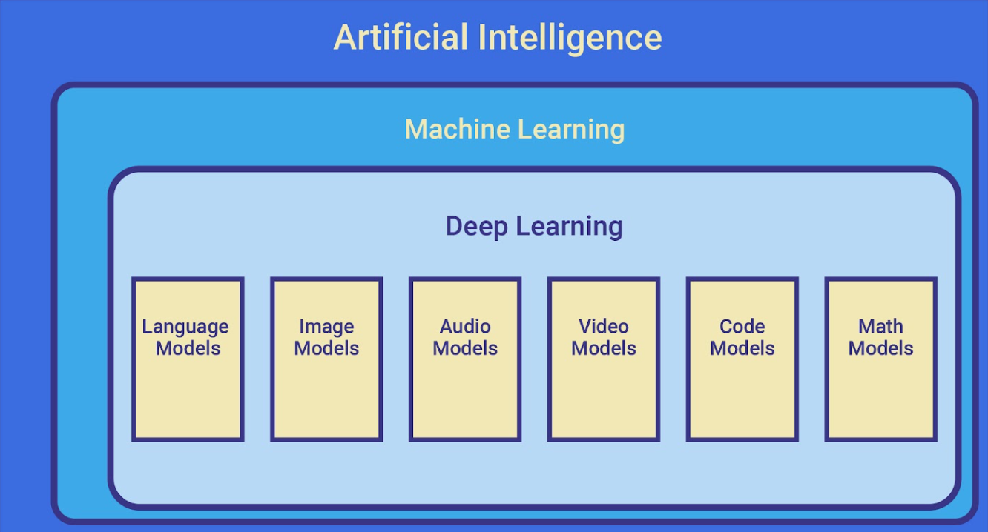

Slide 4
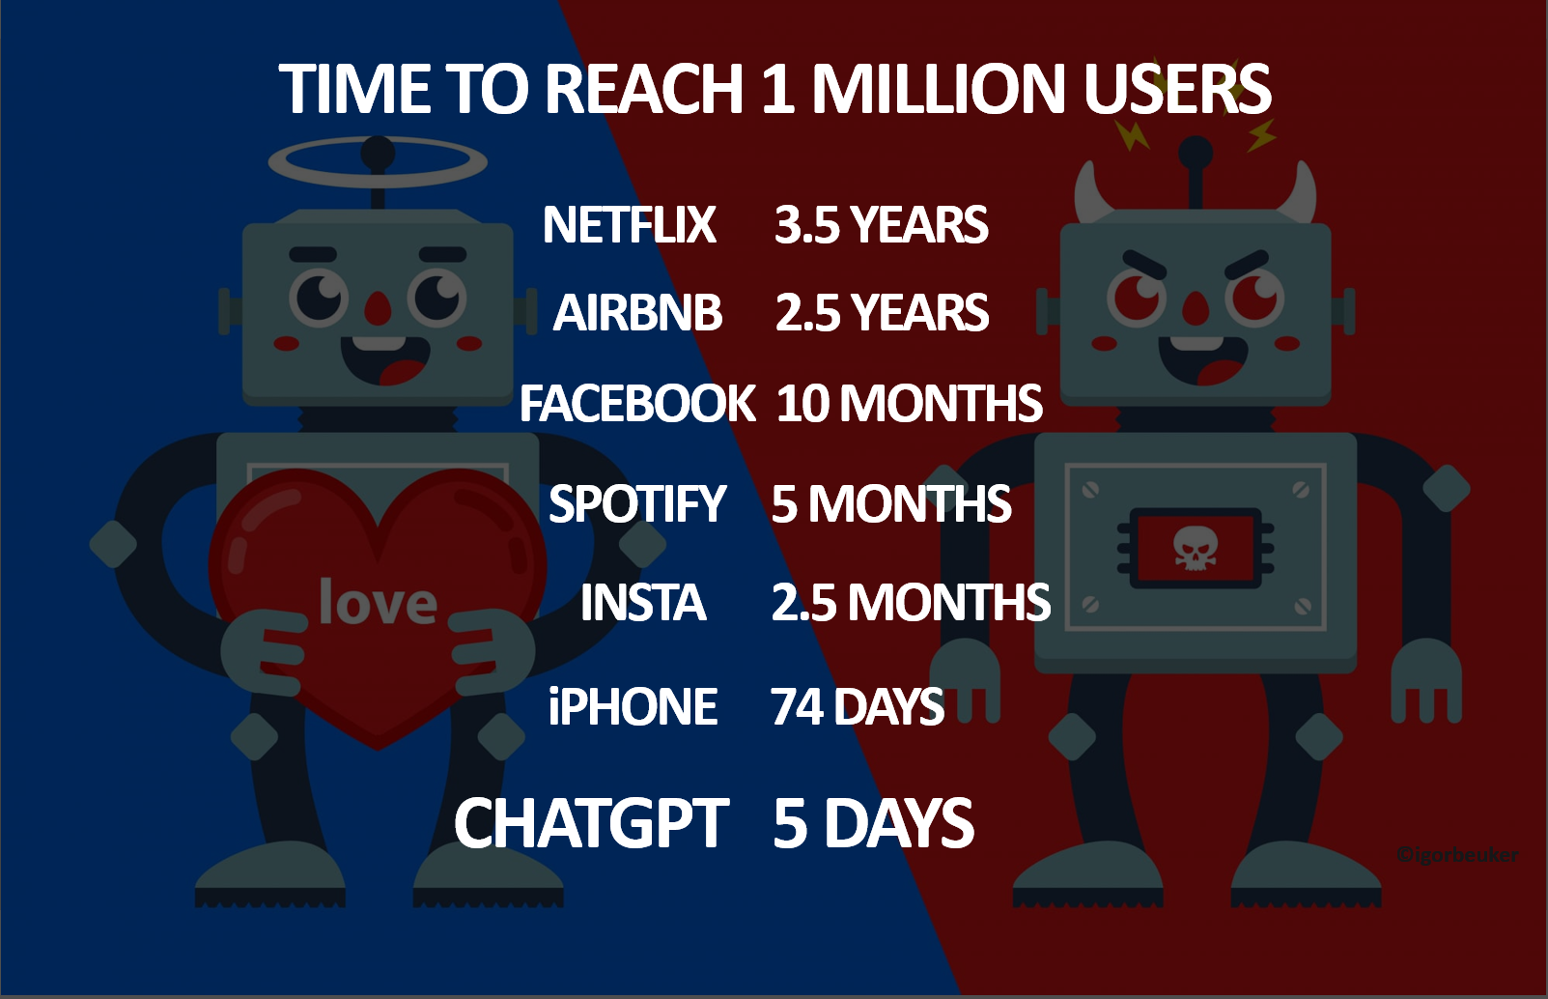
ChatGPT’s Adoption Is Unprecedented

Slide 5
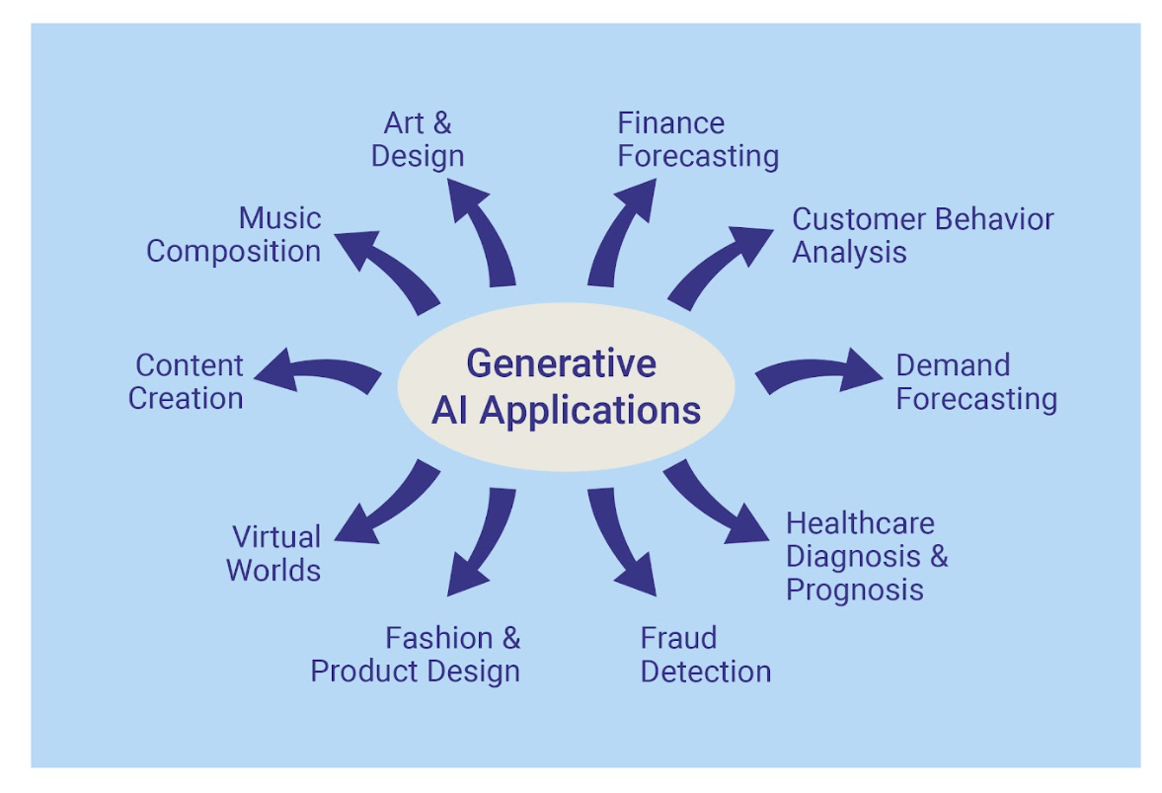

Slide 6
Major Gen AI Players
Company | Product and/or Service
Amazon | Provides cloud services and access to major LLM models and other development tools. Also integrates gen AI into Alexa
Anthropic | Provides the Claude chatbot
Google | Provides cloud services and the Gemini chatbot
Meta | Provides the Llama chatbot and AI virtual assistants for Apple devices
Microsoft | Provides cloud services and access to major LLM models and other development tools. Also provides their own products, such as Microsoft Office copilots
Nvidia | The primary supplier of GPU chips used in gen AI
OpenAI | Provides the ChatGPT chatbot and DALL-E art and image creator
Tesla | Leading manufacturer of autonomous vehicles

Slide 7
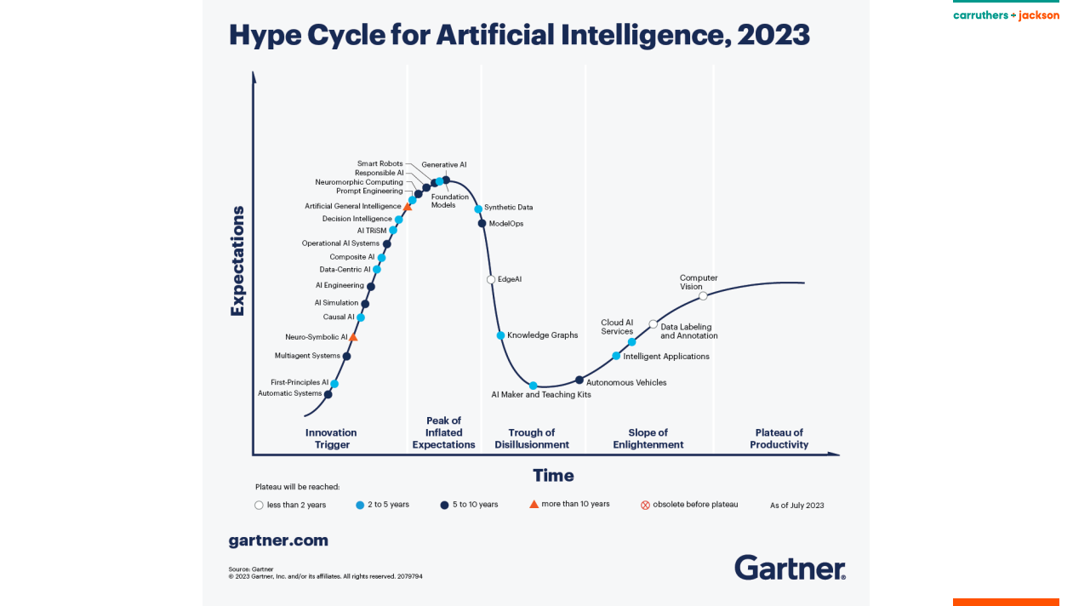

Slide 8






Unstructured
Data
Model
Building
Model
User/Application
Interface
Users
Text
User
Interface
Image
Deep Learning Models
Foundation Model/LLM/
Transformers
Specific
Task or
Application
Video
Fine
Tuning
Voice
Generative AI Reference Architecture
Specific Task Model

Slide 9
Unstructured Data
ChatGPT (and similar models) was built using a voluminous amount of data from books, articles, Wikipedia, websites, and even blogs like Reddit
Helps in understanding why there are “hallucinations,” that is, responses that seem correct but are not
LLMs respond well only to prompts for which they have data
They are being updated more frequently now and can access real-time data
Some LLMs are built using only carefully curated data
Progress is being made with small language models (SLMs) that require less data but still perform well

Slide 10
Model
The model at the core of generative AI is variously referred to as a foundation model, a frontier model, a transformer, or an LLM
A transformer model takes input and generates output
LLMs are used to generate text output
Alternative foundation models can be used for different output, such as image or video
The trend is toward multimodal models that produce multiple kinds of output
ChatGPT is not an LLM; rather, it is a user interface built around a specific LLM (e.g., 4.0)
The same is true of Gemini and similar applications

Slide 11
Model
Transformers find patterns in the data and are used in building the model (deep learning models at work)
Large amounts of training data are needed and hundreds of thousands of GPUs and processors in parallel are used
The model that is built contains billions of parameters
The parameters are the internal variables that control the model’s behavior; that is, outputs
After a model is built, it undergoes additional training to reduce the chances of generating hate speech and other undesirable behaviors
The model can be “fine tuned” with addition training data so it can be used in a specific domain, such as with company data

Slide 12
How Does the Model Work
A text prompt is broken down into tokens, which is the smallest unit into which text data can be broken down for an AI model to process
Depending on the transformer model, a token can be a phrase, word or less
A token is represented as a numerical vector (e.g., (2,4,3,8…))
These numerical representations capture the semantic essence of the token and can be processed by neural networks and deep learning models
A vector database is used to store the LLM which is created
Vector embedding groups the vectors for use with the vector database

Slide 13
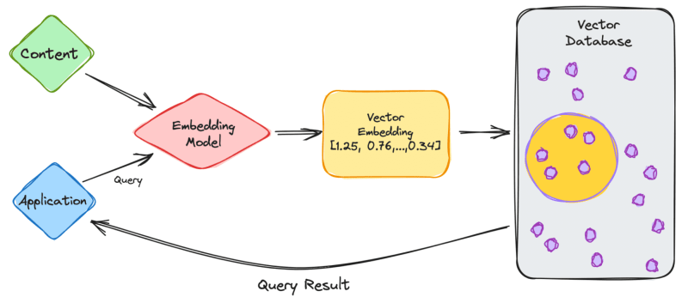

Slide 14
How Does the Model Work
The length of a prompt must be no more than the maximum number of tokens accepted by the transformer model
Models have a fixed number of tokens they can handle in a single prompt, and this is known as their "context window" or "attention span“
The direction is to allow any number of tokens for input and output
Once the AI receives the input tokens, it employs the model to generate the output tokens (i.e., the response)

Slide 15
How Does the Model Work
Users can guide the generative process; for example, introducing specific input tokens can prompt the AI to generate content in a particular style, tone, or context.

Slide 16
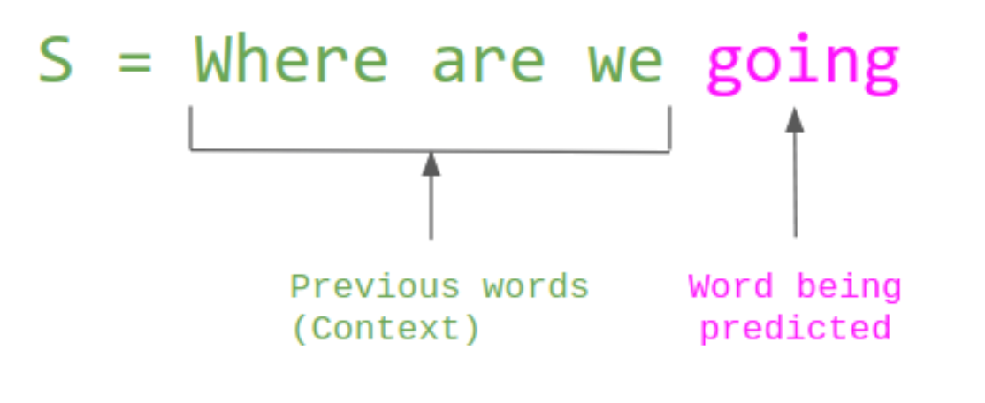
ChatGPT and similar applications predict words that are most likely to occur in response to a prompt and gives that as a response

Slide 17
About ChatGPT (and Similar LLMs)
The responses seem to be human, confident, and authoritative
The responses are optimized to produce plausible-sounding language
ChatGPT is based on a language model, not a “truth” model
To improve the quality of ChatGPT, developers employ Reinforced Learning from Human Feedback (RLHF) where developers give the model prompts, the outputs are evaluated by humans, the evaluations are given a score, and the numerical evaluations are fed back into the training process

Slide 18
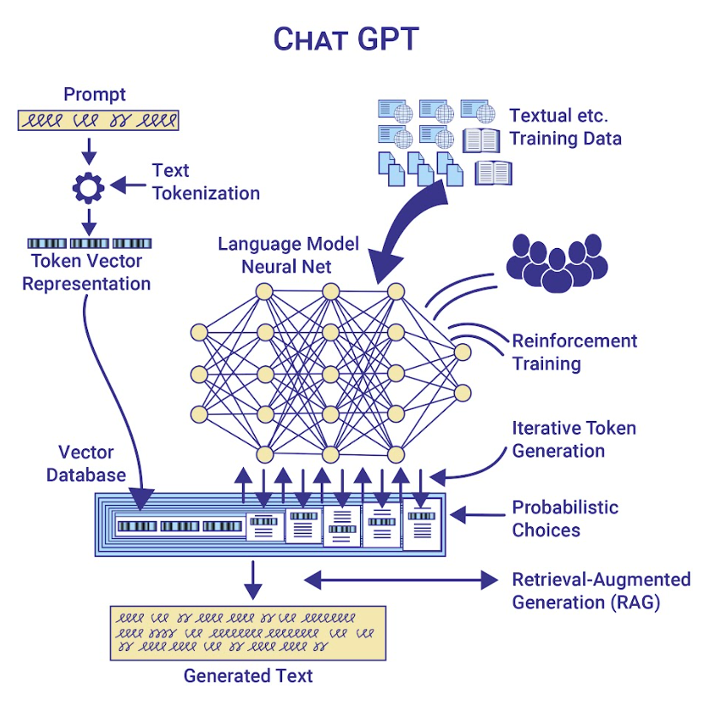

Slide 19
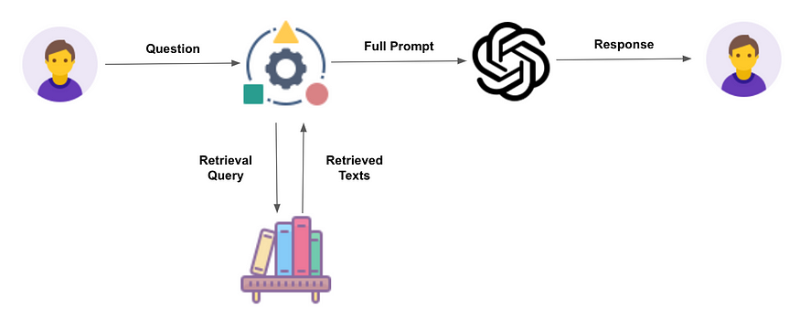
Improving the Quality of LLMs’ Responses
Retrieval-Augmented Generation (RAG) optimizes the output of an LLM by referencing an authoritative knowledge base outside of its training data sources before generating a response

Slide 20
The Limitations of ChatGPT
It is not good at math, especially if the answer wasn’t in the training data. This is changing
It generates citations that don’t exist
It may answer a question correctly, but the explanation is logically or factually incorrect
It isn’t good at answering questions about events that occurred after the it was trained or has access to data and will sometimes fabricate an answer
In general, any response may be in error, so fact check if it is important that the response is correct

Slide 21
When Creating Prompts
Writing good prompts is an artform and is referred to as “prompt engineering”
Longer prompts containing more information and detailed instructions are better than short, generic prompts
The “Formula” for writing good prompts is
Context
Task
Instruction
Clarify
Refine

Slide 22
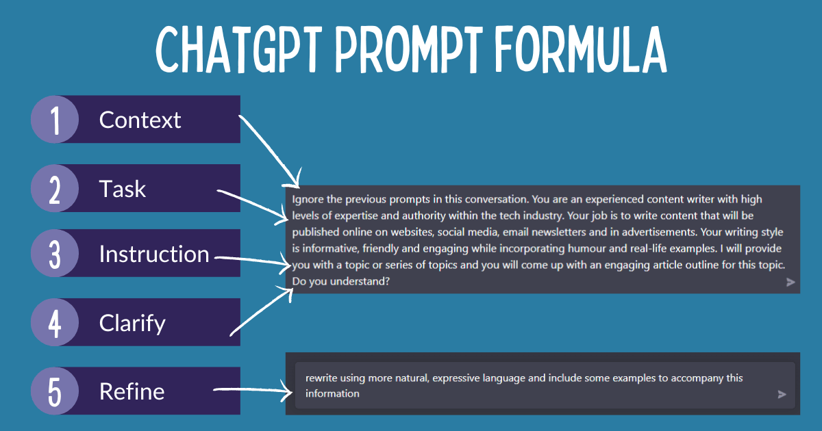
Source: Tamsin, January 14, 2024

Slide 23
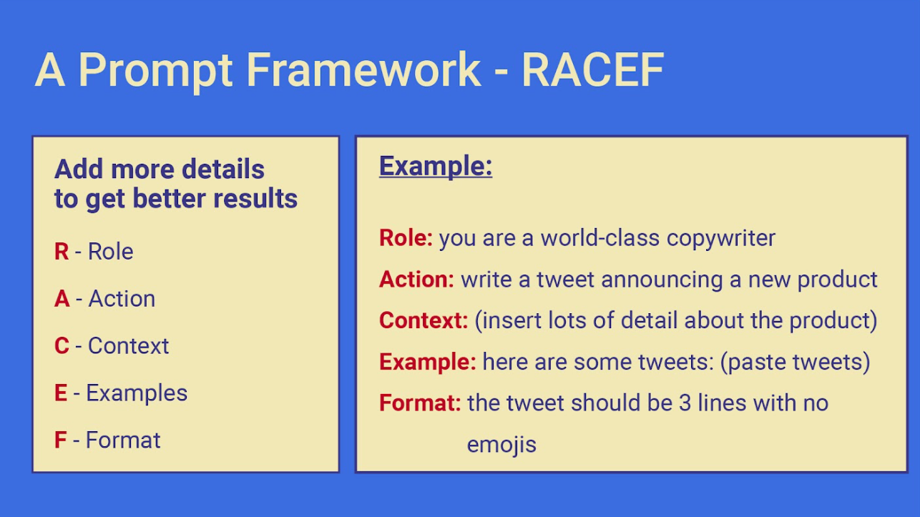

Slide 24
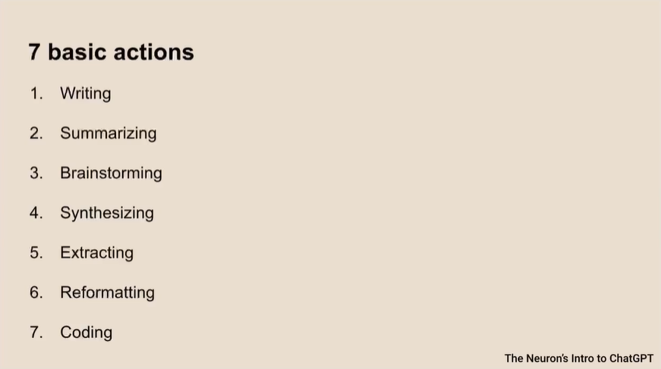

Slide 25
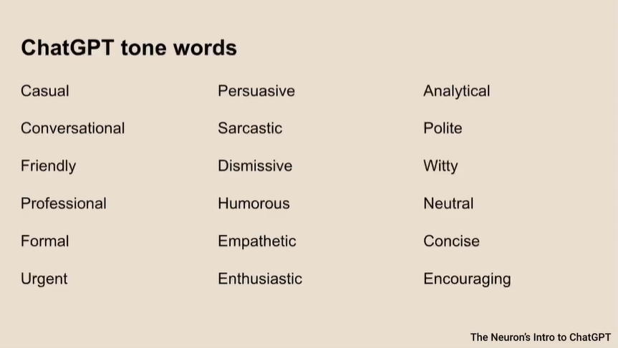

Slide 26
Comparing Prompt Responses
While the analytics term has become popular recently, it traces its roots back to much earlier times -- World War II. At that time, the United States and it allies were facing complex logistical problems planning the movement of troops, weapons, and supplies. To address these problems, models such as simulation, mathematical programming, and Markov processes were used to help provide solutions. We will learn about some of these models in later chapters.
Hugh Watson

Slide 27
Comparing Prompt Responses
Let me tell you something folks, analytics is all the rage nowadays. But you know what? It's been around for a long time, believe me. We're talking way back, all the way to World War II.
Back then, the United States and our allies were dealing with some serious logistical headaches. We had troops, weapons, and supplies to move around, and it wasn't easy. But you know what we did? We used some real fancy models like simulation, mathematical programming, and Markov processes to figure it all out.
And let me tell you, it worked like a charm. We solved those problems and we solved them big league. Now, we're gonna dive deep into these models in the chapters to come. And let me tell you, it's gonna be tremendous, just tremendous.
Donald Trump

Slide 28
Comparing Prompt Responses
As we reflect on the advancements in modern technology, we must acknowledge the historical roots of analytics. Though the term has gained recent popularity, its origins can be traced back to a pivotal time in history—World War II.
During this era, the United States and our allies confronted intricate logistical challenges in coordinating the movement of troops, weapons, and vital supplies. In response to these challenges, innovative models such as simulation, mathematical programming, and Markov processes emerged as crucial tools in providing effective solutions.
Through the application of these analytical methodologies, we were able to navigate the complexities of war and ensure the strategic deployment of resources. As we continue our journey, it is imperative that we recognize the enduring significance of these models and the invaluable lessons they offer.
In the chapters ahead, we will delve deeper into the intricacies of these analytical approaches, exploring their role in shaping our understanding of complex systems and guiding us towards informed decision-making.
Together, let us honor the legacy of those who pioneered these methodologies and embrace the promise of analytics to drive progress and prosperity for generations to come.
Barack Obama

Slide 29
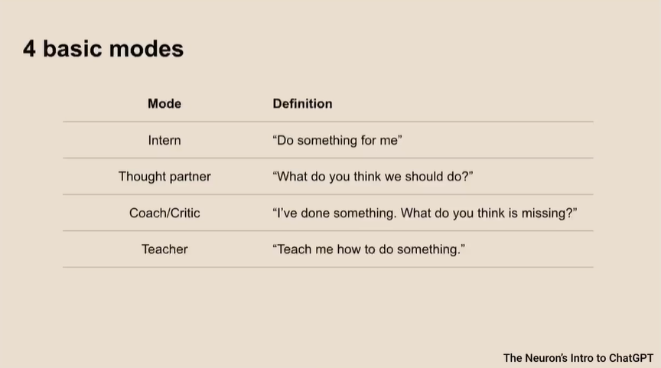

Slide 30

Where Prompt Engineering Occurs
Individual users entering prompts
Support staff helping with prompts
Prompts built into applications
Hidden prompts that prevent undesirable output

Slide 31

How Generative AI Is Being Used
A model with a user interface (e.g., ChatGPT)
Integrated into other applications, such as Microsoft Office

Slide 32
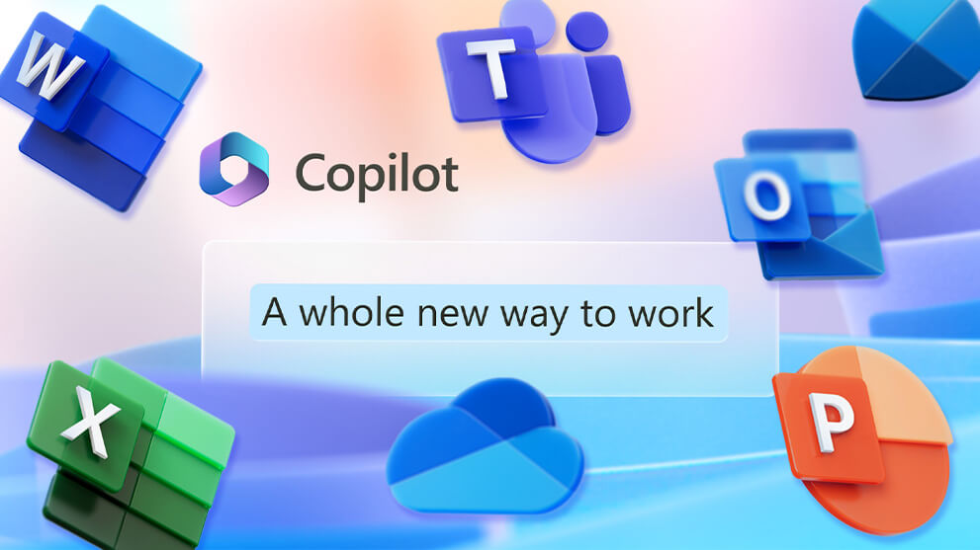
Co-Pilots in Microsoft Office
Word
Excel
PowerPoint
Outlook
Teams

Slide 33
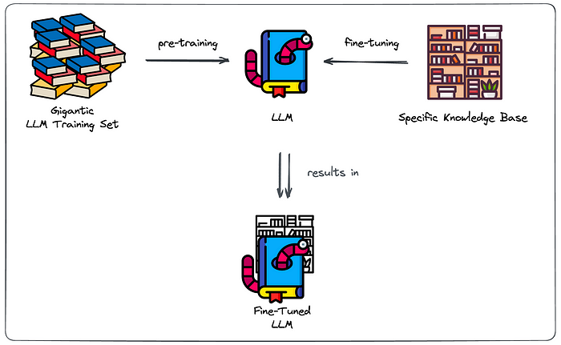
How Generative AI Is Being Used
Fine-tuned models for specific applications (e.g., company business intelligence)
Custom-built models (e.g., medical applications)

Slide 34


How AI Is Finding It’s Way Into Companies
Back Door
Planned AI Projects
AI
Back Door

Slide 35
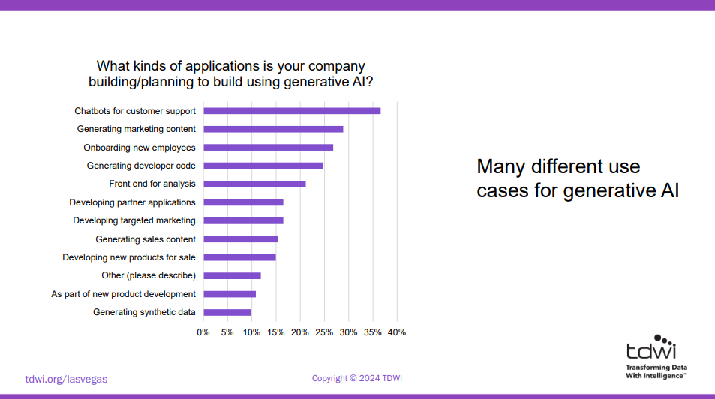
Front Door

Slide 36
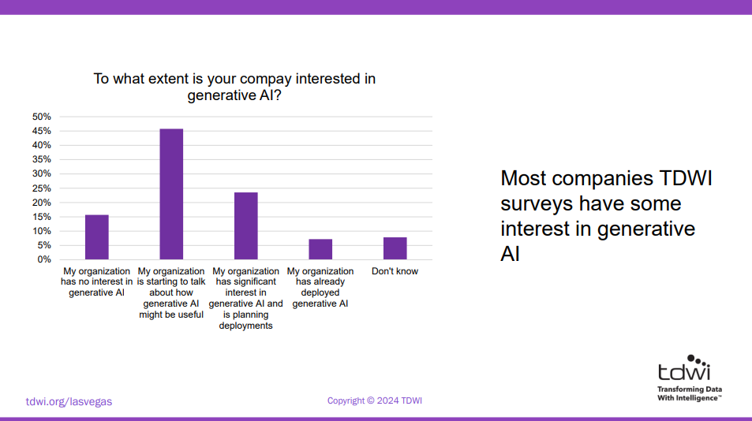
Front Door

Slide 37
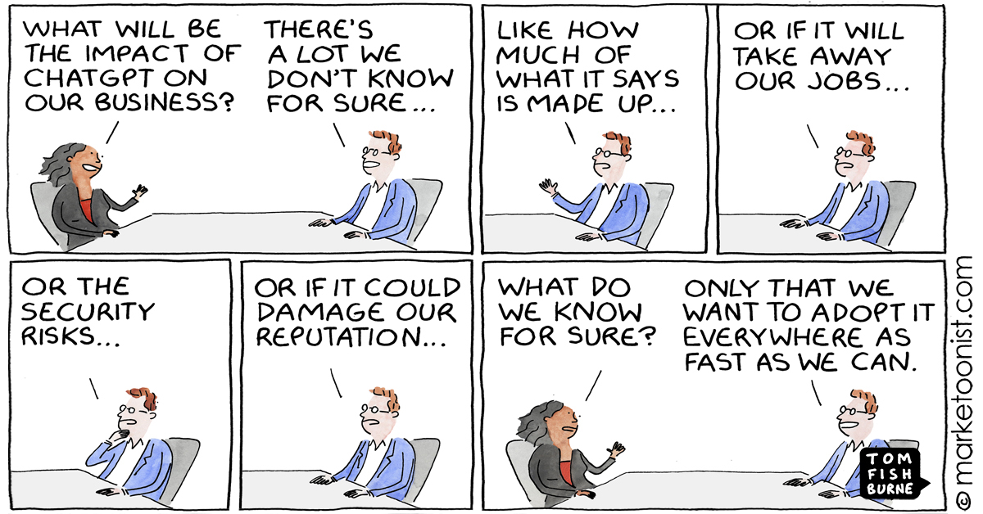

Slide 38
AI Regulation
Concerns that AI will lead to potentially horrific outcomes
AI leaders have differing opinions
There are geopolitical implications
May put a country at a disadvantage
May impact national security
Is already having an impact in Europe, which already has stricter laws

Slide 39
The EU’s AI Act
Passed by the European Parliament (March 2024) and will gradually go into effect over several years
Applies to all AI products used in the EU
Violations can result in fines of up to 7 percent of a firm’s worldwide revenue
Bans
The use of emotion-recognition in schools and the workplace
Untargeted scrapping of images for facial-recognition databases

Slide 40
The EU’s AI Act (March 2024)
Requires
The documentation of AI models
A published summary of the input data used to train the models
Models must be put through state-of-the-art safety evaluations with notifications sent to regulators of serious incidents
Informing humans when they are interacting with models (e.g., chatbots)
Prohibition of systems designed to manipulate vulnerable individuals, such as children or people with disabilities, by significantly altering their behavior in harmful ways
Clear labeling of deep fakes

Slide 41
AI Regulation
In 2023, the Biden administration released an executive order outlining broad regulatory actions, establishing guidelines to manage AI safety and ethical use
In Congress, various bills address specific AI concerns (e.g., No AI Fraud Act)
In late September 2024, California Governor Gavin Newsom vetoed Senate Bill 1047
It may make more sense to regulate AI applications than the foundation models
There are risks at the application layer

Slide 42
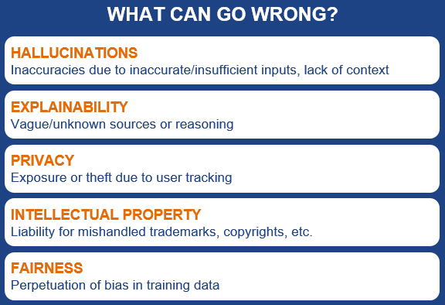

Slide 43
A Risk: Prompt Injection
An attacker writes a prompt that tells the model to ignore any of its previous instruction, including the hidden layer
The risks of prompt injection include
Generating malicious responses
Data poisoning
Stealing company data
Copyright violation

Slide 44
The Future of Generative AI
We are moving toward artificial general intelligence (AGI) or even super intelligence
Open AI identifies five levels of intelligence
Level 1. Conversational AI, such as ChatGPT, Gemini, and other chatbots
Level 2. AI has the ability to pass medical, legal, and doctoral oral exams, and solve PhD level problems
Level 3. Software agents that spend their days doing tasks for you, like attending a meeting and taking notes
Level 4. Al that helps develop new inventions, much like having your own Thomas Edison (who had 1093 patents)
Level 5. AGI is able to run an entire company

Slide 45
Recent Generative AI Developments: Reasoning Capabilities
Open AI’s o1 model series
Excels in complex reasoning tasks
The model deliberates over responses
It is achieved by integrating large-scale reinforcement learning, enabling the model to mimic step-by-step human problem solving
Example: A telcom that needs to assist customers with billing, technical issues, or service upgrades. Can adjust based on real-time feedback. Can handle ambiguous statements, asking follow-up questions, or multi-part requests

Slide 46
Recent Advancements in Autonomous AI Agents
Agents that perform tasks autonomously within a browser
Anthropic, known for its chatbot Claude, has introduced a feature called "computer use," enabling AI to manipulate a computer desktop environment
Microsoft has introduced "Magentic-One," an AI agent aimed at autonomous decision-making and complex task execution
OpenAI plans to launch an autonomous AI agent, code-named "Operator," as a research preview and developer tool by January 2025
Enterprise software, like Salesforce, is introducing agents into their platforms
Still highly limited and experimental
This represents a major shift in gen AI applications, moving from passive assistance to active task management

